Slide 1

OPERATING SYSTEM CASE STUDY-FREEDOS
Presented by:-
Debojyoti Malakar (24261A05L9)
Emmadapuram Sampreethi (24261A05M0)
G Suhas Reddy (24261A05M1)
CSE 4
Mahatma Gandhi Institute of Technology

Slide 2
INTRODUCTION
Why are we using FreeDOS?
Open-source DOS-compatible operating system
Lightweight and command-line based
Supports legacy software execution
Suitable for learning basic OS concepts

Slide 3
History and relevANCE
Started in 1994
Developed by Jim Hall
Created as replacement for DOS
Open-source community maintained

Slide 4
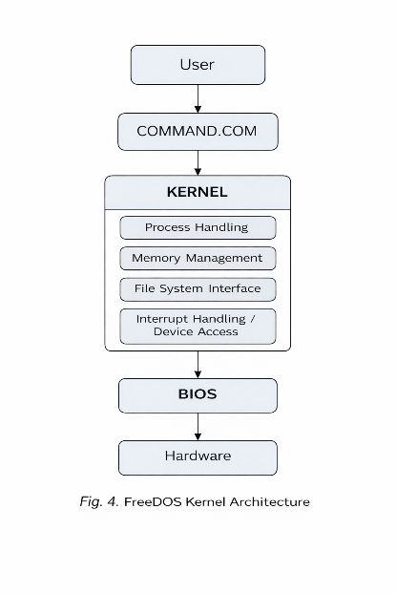
SYSTEM ARCHITECTURE
User interacts through COMMAND.COM
Kernel handles core services
BIOS provides hardware access
Monolithic DOS-style architecture

Slide 5
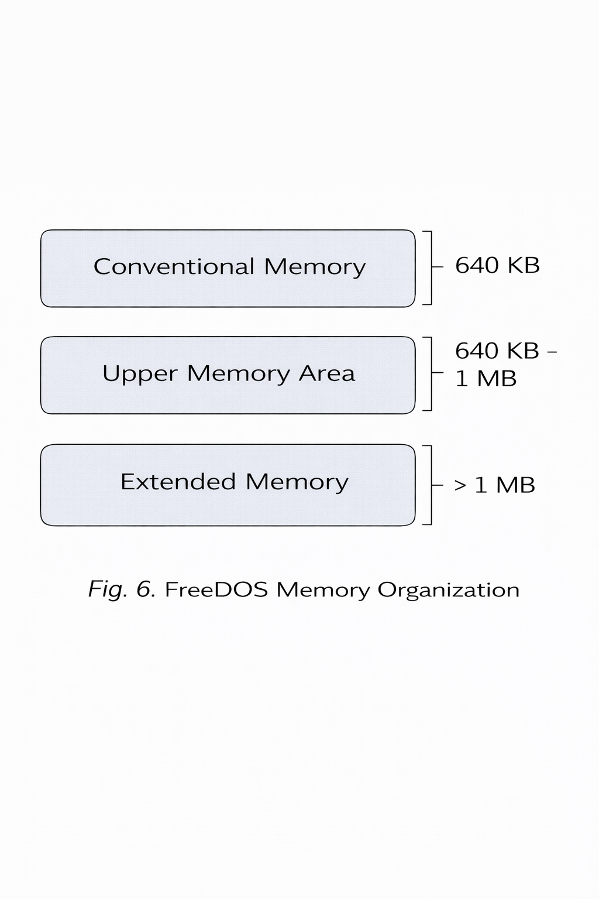
Memory management
Conventional Memory: 640 KB
Upper Memory Area: 640 KB–1 MB
Extended Memory: Above 1 MB
HIMEM and EMM386 used

Slide 6
File system management
Uses FAT file system
Supports FAT12, FAT16, FAT32
Stores files in clusters
Simple and efficient allocation

Slide 7
demonstration
Command-line execution in FreeDOS
Basic commands used:
DIR
CD\
CLS
MEM
VER
TYPE

Slide 8
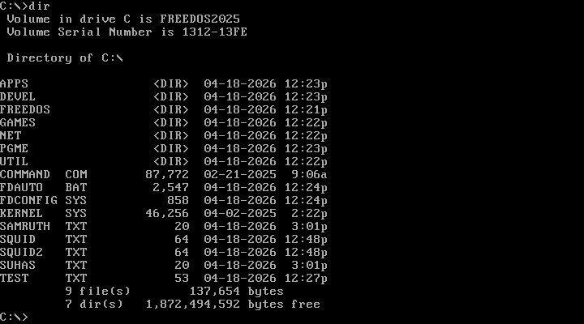
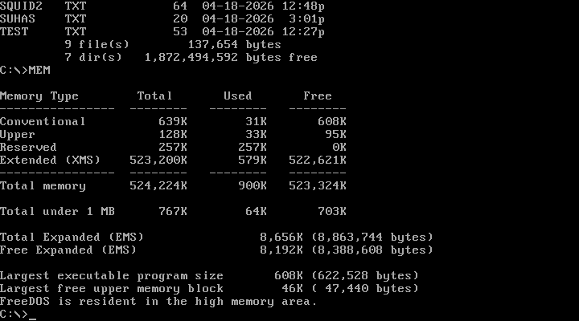
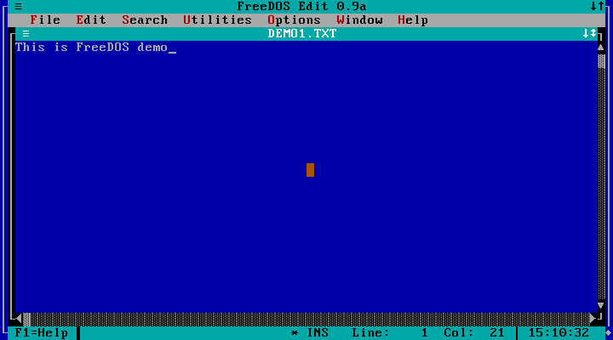
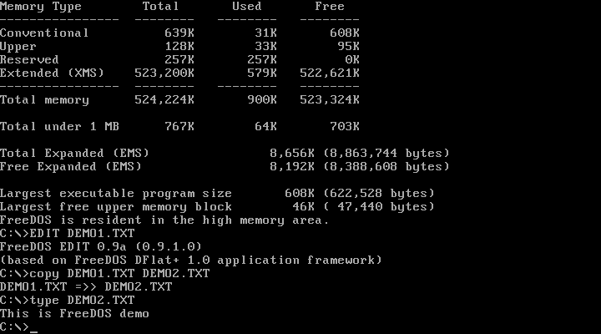

Slide 9
Advantages and limitations
Advantages:
Lightweight
Fast execution
Open-source
Limitations:
No graphical interface
Single-tasking
Limited security

Slide 10
conclusion
FreeDOS explains core OS concepts clearly
Useful for legacy systems and education
Simple architecture supports learning

